Slide 1
A&O Group Meeting
November 15, 2017

Slide 2
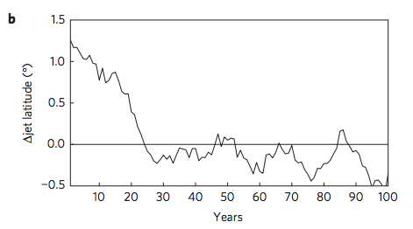
Shaw & Voigt 2015: 4xCO2 N Pacific jet latitude.

Slide 3
1 time scale response
2 time scale response

Slide 4
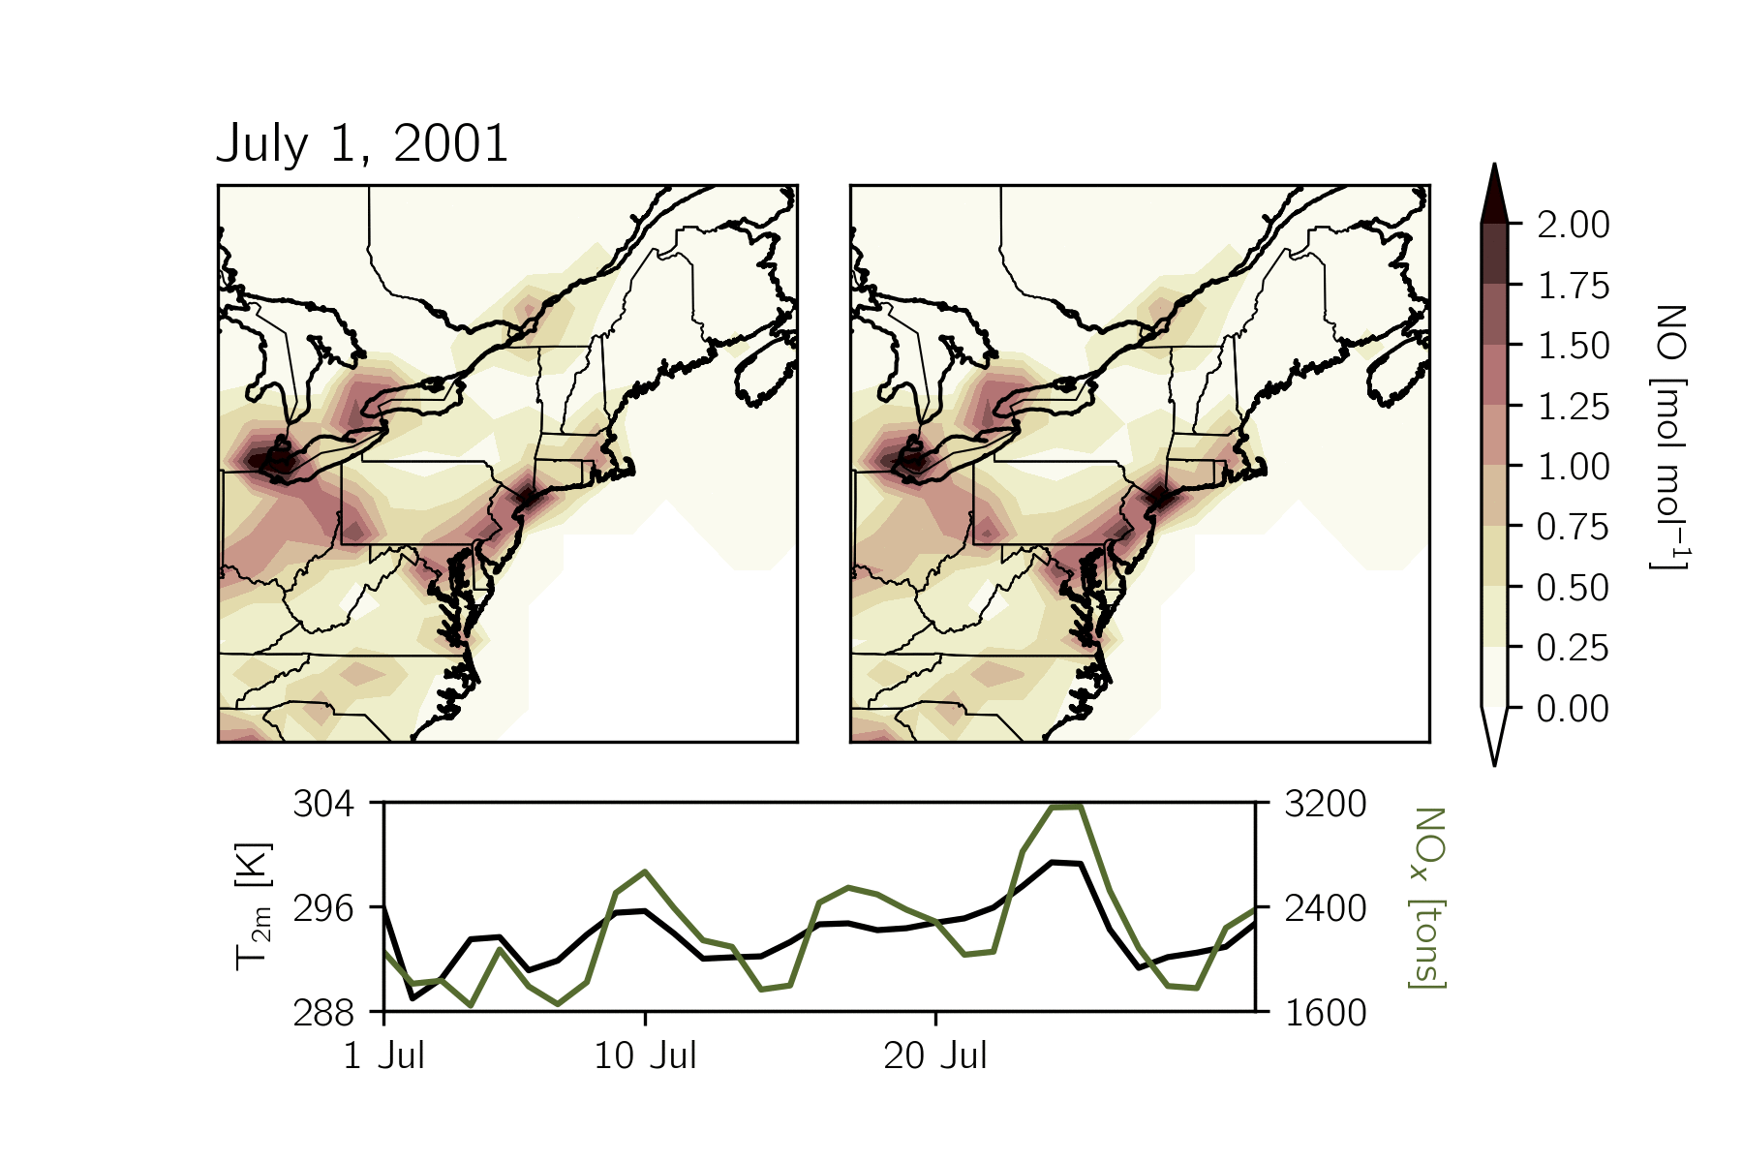


Slide 6
Secchi depth (cm)
Monthly precipitation (mm)

Slide 7
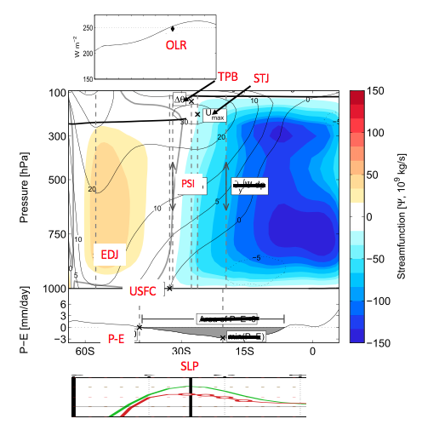
Change in zonal-mean fields associated with an equatorward (dashed) or poleward (solid) shift in Psi-500 = 0 (Hadley Cell edge).
Similar shift in latitude where maximum sea-level pressure (SLP), maximum westerlies (EDJ), and surface winds=0 (USFC).
But no change in latitude where OLR=250 (OLR), maximum subtropical winds (STJ) or tropopause break (TPB).
TPB shifts poleward as STJ shifts poleward.
0
0
0

